Slide 1
THE LINKEDIN
FORMULA FOR CEOS
GET FURTHER FASTER
LINKEDIN
FORMULA
FURTHER FASTER

Slide 2
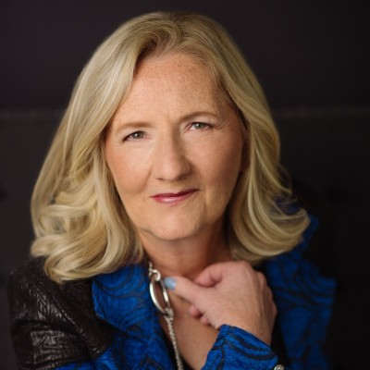
JUDY SCHRAMM
ANN MARIE BEEBOUT
CEO
Executive Coach
jschramm@proresource.com
abeebout@proresource.com
LINKEDIN
FORMULA
FURTHER FASTER
PRORESOURCE, INC.

Slide 3
Agenda
Why your presence on LinkedIn matters
Examples of CEOs with a strong presence
Formula for aligning your presence with your goals
Designing a LinkedIn system
Hot Seats
LINKEDIN
FORMULA
FURTHER FASTER
P R O R E S O U R C E , I N C .

Slide 4
Why LinkedIn?
P R O R E S O U R C E , I N C .
L I N K E D I N F O R M U L A

Slide 5
78% of C-level executives say they Google someone before they meet them.
LINKEDIN
FORMULA
FURTHER FASTER
P R O R E S O U R C E , I N C .

Slide 6
Microsoft acquired LinkedIn in 2016
for $26.2 billion
LINKEDIN
FORMULA
FURTHER FASTER
P R O R E S O U R C E , I N C .

Slide 7
When you tell a powerful and compelling
story on LinkedIn, you effectively
control the first page of Google search results
LINKEDIN
FORMULA
FURTHER FASTER
P R O R E S O U R C E , I N C .

Slide 8
LinkedIn’s 950 million members include your
LINKEDIN
FORMULA
FURTHER FASTER
P R O R E S O U R C E , I N C .

Slide 9
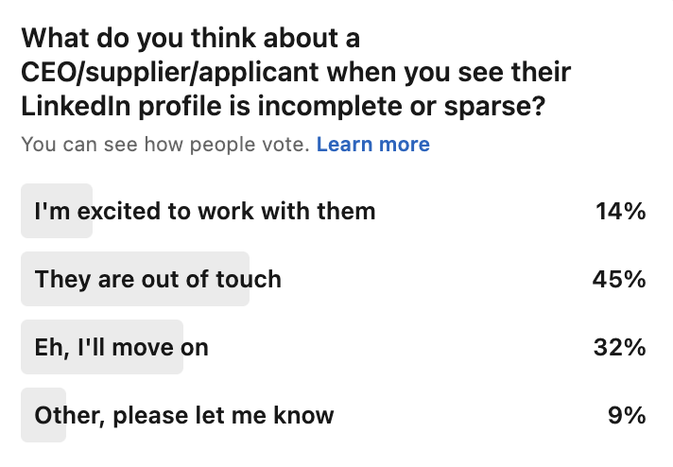
When your presence is empty or outdated, you miss opportunities
“It is unwise to expect your profile to work for you unless you keep it updated. Each and every update has the possibility to help initiate an opportunity you would not have otherwise had access to.”
Fred Coon, CEO
LINKEDIN
FORMULA
FURTHER FASTER
P R O R E S O U R C E , I N C .

Slide 10
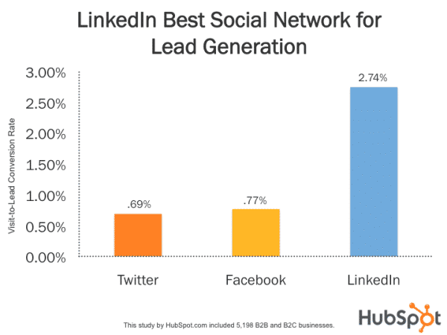
LINKEDIN
FORMULA
FURTHER FASTER
P R O R E S O U R C E , I N C .

Slide 11
54% of job seekers in the US
research the CEO in social media
LINKEDIN
FORMULA
FURTHER FASTER
P R O R E S O U R C E , I N C .

Slide 12
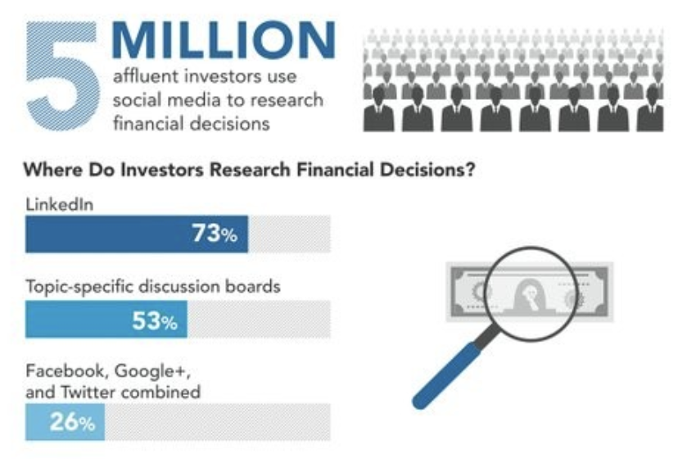
LINKEDIN
FORMULA
FURTHER FASTER
P R O R E S O U R C E , I N C .

Slide 13
Where is the ROI?
Increase brand awareness
More say yes to a conversation
Save time in meetings
Speed progress through your funnel
P R O R E S O U R C E , I N C .
L I N K E D I N F O R M U L A

Slide 14
CEO Examples on LinkedIn
P R O R E S O U R C E , I N C .
L I N K E D I N F O R M U L A

Slide 15
CEO LinkedIn Formula
P R O R E S O U R C E , I N C .
L I N K E D I N F O R M U L A

Slide 16
LinkedIn Formula for CEOs –
If you have one primary focus, your job is easier.
LINKEDIN
FORMULA
FURTHER FASTER
P R O R E S O U R C E , I N C .

Slide 17
Focus your LinkedIn presence on that audience,
provide the information they need to say yes!
Speak to the people who matter most. What do they need to know about you?
CEO networks should be 1000+. Connect with your target audience plus people respected by them.
What education will serve your goals, interest your audience, and maintain mindshare?
Engage with your audience and the people they respect.
LINKEDIN
FORMULA
FURTHER FASTER
P R O R E S O U R C E , I N C .

Slide 18
The 3 Stories Everyone Needs to Hear…
Vision (Founding Story)
Your Traction
Your Culture
LINKEDIN
FORMULA
FURTHER FASTER
P R O R E S O U R C E , I N C .

Slide 19
An effective CEO presence saves time, makes it easier to grow your business!
Increase brand awareness – you get more opportunities
More – of the right people – say yes to a conversation
People come to the first meeting better prepared
Maintain mindshare through your funnel
P R O R E S O U R C E , I N C .
L I N K E D I N F O R M U L A

Slide 20
How We Help
P R O R E S O U R C E , I N C .
L I N K E D I N F O R M U L A

Slide 21
Ideal LinkedIn System
Strategy aligned with your goals
Delegate as much as possible
Everyone knows what to do, happens automatically
LINKEDIN
FORMULA
FURTHER FASTER
P R O R E S O U R C E , I N C .

Slide 22
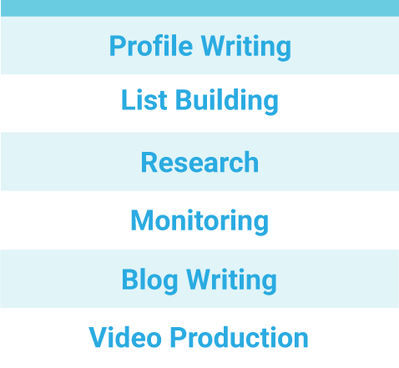
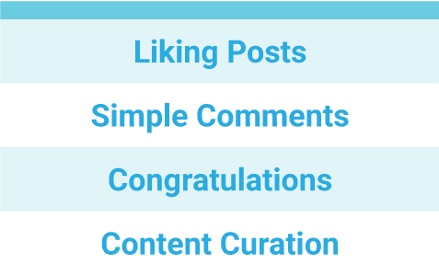
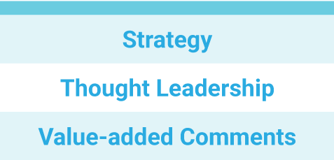
DELEGATE EFFECTIVELY
DELEGATE THIS
MAYBE THIS
NOT THIS
LINKEDIN
FORMULA
FURTHER FASTER
P R O R E S O U R C E , I N C .

Slide 23
How We Help
LinkedIn experts design your strategy
Workflow maximizes delegation
Writing is done for you
Our team keeps everyone on schedule
LINKEDIN
FORMULA
FURTHER FASTER
P R O R E S O U R C E , I N C .

Slide 24
We Provide
LINKEDIN
FORMULA
FURTHER FASTER
P R O R E S O U R C E , I N C .

Slide 25
Schedule a Free Consultation
https://calendly.com/proresource/30min
LINKEDIN
FORMULA
FURTHER FASTER
P R O R E S O U R C E , I N C .

Slide 26
HOT SEAT
Enrich Your Profile
P R O R E S O U R C E , I N C .
L I N K E D I N F O R M U L A

Slide 27
Our Methodology
LINKEDIN
FORMULA
FURTHER FASTER
P R O R E S O U R C E , I N C .

Slide 28
HOT SEAT
LinkedIn Strategy
P R O R E S O U R C E , I N C .
L I N K E D I N F O R M U L A

Slide 29
Focus your LinkedIn presence on that audience,
provide the information they need to say yes!
LINKEDIN
FORMULA
FURTHER FASTER
P R O R E S O U R C E , I N C .

Slide 30
HOW WE CAN HELP
LINKEDIN
FORMULA
FURTHER FASTER
P R O R E S O U R C E , I N C .

Slide 31
Schedule Your Free Consultation
Special for today’s attendees:
We will email you a short Loom video
Providing feedback on your profile.
https://calendly.com/proresource/30min
LINKEDIN
FORMULA
FURTHER FASTER
P R O R E S O U R C E , I N C .

Slide 32
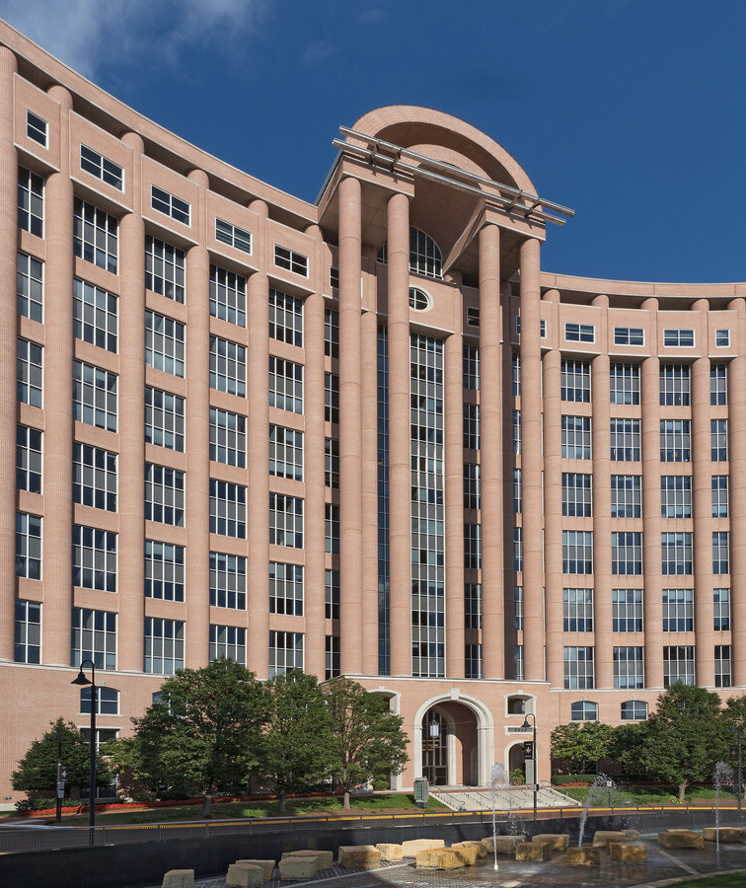
JUDY SCHRAMM
ANN MARIE BEEBOUT
CEO
Executive Coach
ProResource, Inc.
8000 Towers Crescent Drive
Suite 1350
Vienna, VA 22182
+1 703-824-8482
PRORESOURCE.COM
jschramm@proresource.com
abeebout@proresource.com

Slide 33
YOUR PERSONAL BRAND
LINKEDIN
FORMULA
FURTHER FASTER
P R O R E S O U R C E , I N C .

Slide 34
Sample Branding Blocks
LINKEDIN
FORMULA
FURTHER FASTER
P R O R E S O U R C E , I N C .

